Slide 1
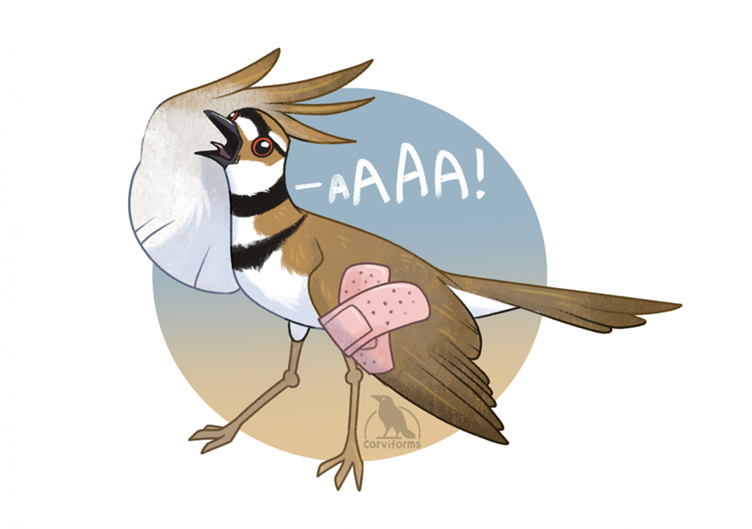
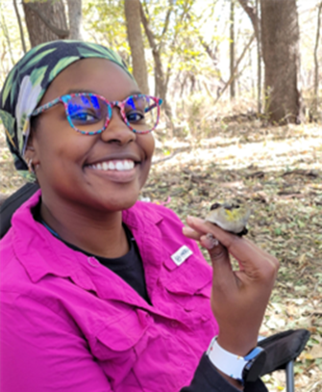
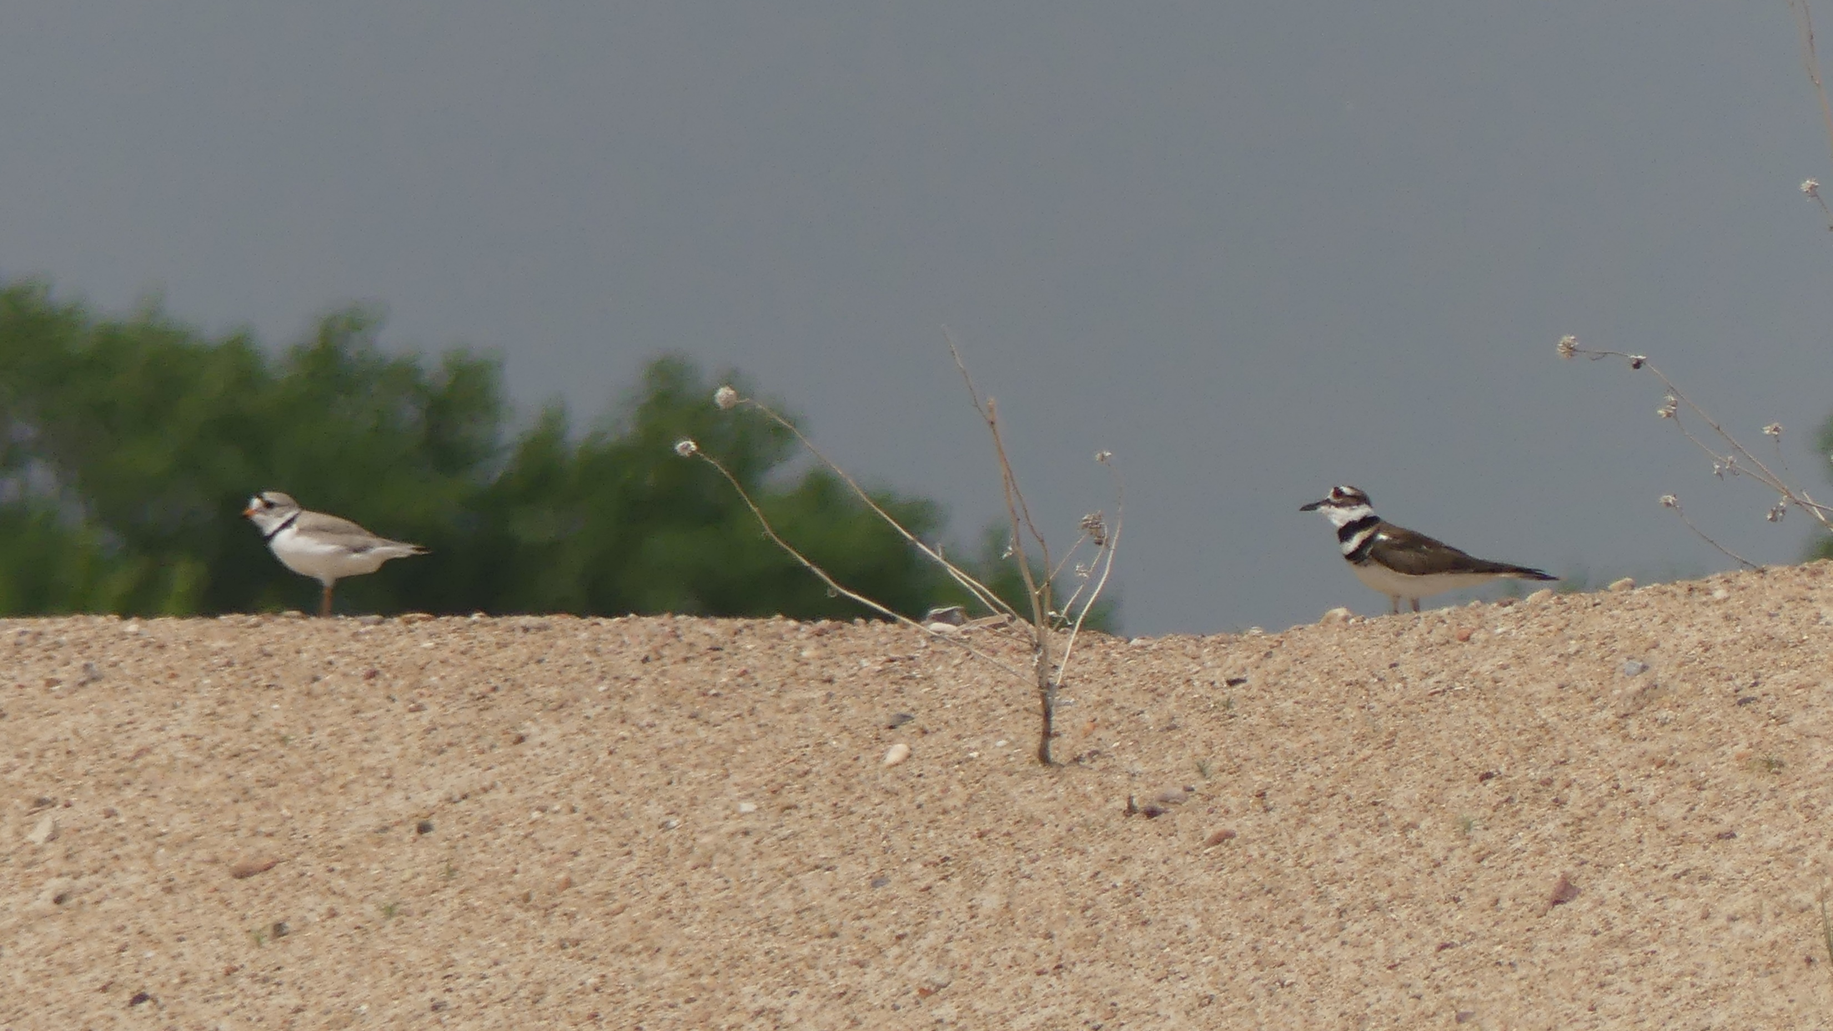
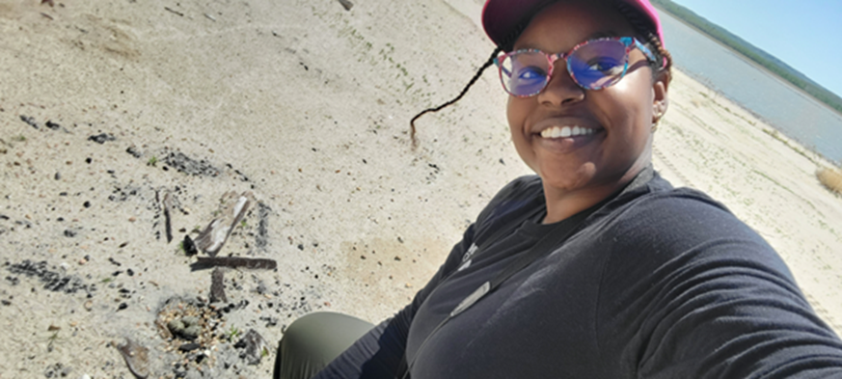

Parental care in Killdeer and Piping Plovers
Brandy Williams
School of Biological sciences, EEB
Shizuka Lab

Slide 2
Big Question: How does individual behavior give rise to community ecology?
What mechanisms are involved in the broken wing display?
Are these mechanisms responsible for individual variation in BWD?
Are Piping plovers benefiting from having Killdeer for neighbors?
Notes:
Overall goal is to apply what we learn from Killdeer to potential conservation efforts for the Piping Plover

